Slide 1


<Hania Abdelrahman>
<04/19/2025>

Slide 2

Outline
Executive Summary
Introduction
Methodology
Results
Conclusion
Appendix

Slide 3
Executive Summary
Methodologies Used:
Collected data using the SpaceX REST API and web scraping techniques
Cleaned and wrangled data using pandas, focusing on missing values and normalization
Performed exploratory data analysis (EDA) with both visualization and SQL queries to uncover trends in launch outcomes, orbit types, payloads, and booster versions
Developed interactive analytics using Folium maps and Plotly Dash dashboards
Built and evaluated multiple machine learning models (Logistic Regression, SVM, Decision Tree, KNN) to predict launch success
Summary of Results:
Identified key launch sites and payload ranges linked to successful outcomes
Visualizations revealed orbit types and booster versions with higher success rates
SQL insights confirmed payload performance across missions and booster efficiency
The interactive dashboard provided dynamic exploration of launch outcomes
The best-performing classification model achieved over 93% accuracy, with high precision and recall

Slide 4
Introduction
🔹 Project Background and Context
SpaceX has transformed space exploration by increasing launch frequency and reducing costs. As the company continues to scale operations, understanding the factors that influence mission outcomes is crucial for improving performance and risk assessment. This project leverages historical SpaceX launch data to uncover patterns, optimize planning, and enable predictive insights using data science techniques.
🔹 Problems You Want to Find Answers To
What launch sites have the highest success rates?
How do orbit type and payload mass affect launch outcomes?
Can we accurately predict the success of a SpaceX launch using machine learning?
What insights can interactive dashboards and maps provide for mission planning?
Notes:
🔹 Project Background and Context
SpaceX has transformed space exploration by increasing launch frequency and reducing costs. As the company continues to scale operations, understanding the factors that influence mission outcomes is crucial for improving performance and risk assessment. This project leverages historical SpaceX launch data to uncover patterns, optimize planning, and enable predictive insights using data science techniques.
🔹 Problems You Want to Find Answers To
What launch sites have the highest success rates?
How do orbit type and payload mass affect launch outcomes?
Can we accurately predict the success of a SpaceX launch using machine learning?
What insights can interactive dashboards and maps provide for mission planning?

Slide 5

Section 1

Slide 6
Methodology
Executive Summary
Data Collection Methodology
Data was collected from two primary sources:
The SpaceX Launches API using requests and pd.json_normalize
Wikipedia’s Falcon 9 launch table using BeautifulSoup for web scraping
The datasets were merged for richer analysis by matching launch dates and IDs
🔹 Data Wrangling
Removed irrelevant or missing columns
Converted datetime columns to proper formats
Standardized column names
Created new derived features like year, success flags, and booster categories
Notes:
Data Collection Methodology
Data was collected from two primary sources:
The SpaceX Launches API using requests and pd.json_normalize
Wikipedia’s Falcon 9 launch table using BeautifulSoup for web scraping
The datasets were merged for richer analysis by matching launch dates and IDs
🔹 Data Wrangling
Removed irrelevant or missing columns
Converted datetime columns to proper formats
Standardized column names
Created new derived features like year, success flags, and booster categories
🔹 Exploratory Data Analysis (EDA)
Used SQL to answer questions such as:
Total and average payloads by agency
Most common booster versions
Sites with highest success rates
Created visualizations to explore trends like:
Payload vs. Orbit success
Flight Number vs. Launch Outcome
Yearly success rate trends
🔹 Interactive Visual Analytics
Created Folium maps to:
Display all launch sites globally
Highlight outcomes (success/failure) with color-coded markers
Built a Plotly Dash app with:
Pie charts for site success rates
Scatter plots showing payload vs. outcome by site
🔹 Predictive Analysis (Classification Models)
Built and compared four classification models:
Logistic Regression
Support Vector Machine
K-Nearest Neighbors
Decision Tree
Evaluated using accuracy, precision, recall, and confusion matrix
The best model achieved 93.33% accuracy on test data

Slide 7
Methodology
Executive Summary
🔹 Exploratory Data Analysis (EDA)
Used SQL to answer questions such as:
Total and average payloads by agency
Most common booster versions
Sites with highest success rates
Created visualizations to explore trends like:
Payload vs. Orbit success
Flight Number vs. Launch Outcome
Yearly success rate trends
Notes:
Data Collection Methodology
Data was collected from two primary sources:
The SpaceX Launches API using requests and pd.json_normalize
Wikipedia’s Falcon 9 launch table using BeautifulSoup for web scraping
The datasets were merged for richer analysis by matching launch dates and IDs
🔹 Data Wrangling
Removed irrelevant or missing columns
Converted datetime columns to proper formats
Standardized column names
Created new derived features like year, success flags, and booster categories
🔹 Exploratory Data Analysis (EDA)
Used SQL to answer questions such as:
Total and average payloads by agency
Most common booster versions
Sites with highest success rates
Created visualizations to explore trends like:
Payload vs. Orbit success
Flight Number vs. Launch Outcome
Yearly success rate trends
🔹 Interactive Visual Analytics
Created Folium maps to:
Display all launch sites globally
Highlight outcomes (success/failure) with color-coded markers
Built a Plotly Dash app with:
Pie charts for site success rates
Scatter plots showing payload vs. outcome by site
🔹 Predictive Analysis (Classification Models)
Built and compared four classification models:
Logistic Regression
Support Vector Machine
K-Nearest Neighbors
Decision Tree
Evaluated using accuracy, precision, recall, and confusion matrix
The best model achieved 93.33% accuracy on test data

Slide 8
Methodology
Executive Summary
🔹 Interactive Visual Analytics
Created Folium maps to:
Display all launch sites globally
Highlight outcomes (success/failure) with color-coded markers
Built a Plotly Dash app with:
Pie charts for site success rates
Scatter plots showing payload vs. outcome by site
🔹 Predictive Analysis (Classification Models)
Built and compared four classification models:
Logistic Regression
Support Vector Machine
K-Nearest Neighbors
Decision Tree
Evaluated using accuracy, precision, recall, and confusion matrix
The best model achieved 93.33% accuracy on test data
Notes:
Data Collection Methodology
Data was collected from two primary sources:
The SpaceX Launches API using requests and pd.json_normalize
Wikipedia’s Falcon 9 launch table using BeautifulSoup for web scraping
The datasets were merged for richer analysis by matching launch dates and IDs
🔹 Data Wrangling
Removed irrelevant or missing columns
Converted datetime columns to proper formats
Standardized column names
Created new derived features like year, success flags, and booster categories
🔹 Exploratory Data Analysis (EDA)
Used SQL to answer questions such as:
Total and average payloads by agency
Most common booster versions
Sites with highest success rates
Created visualizations to explore trends like:
Payload vs. Orbit success
Flight Number vs. Launch Outcome
Yearly success rate trends
🔹 Interactive Visual Analytics
Created Folium maps to:
Display all launch sites globally
Highlight outcomes (success/failure) with color-coded markers
Built a Plotly Dash app with:
Pie charts for site success rates
Scatter plots showing payload vs. outcome by site
🔹 Predictive Analysis (Classification Models)
Built and compared four classification models:
Logistic Regression
Support Vector Machine
K-Nearest Neighbors
Decision Tree
Evaluated using accuracy, precision, recall, and confusion matrix
The best model achieved 93.33% accuracy on test data

Slide 9
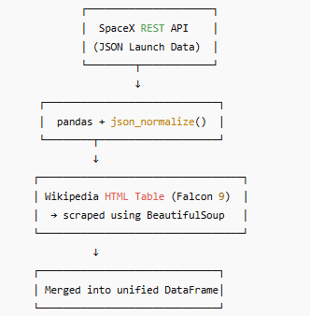
Data Collection

Slide 10
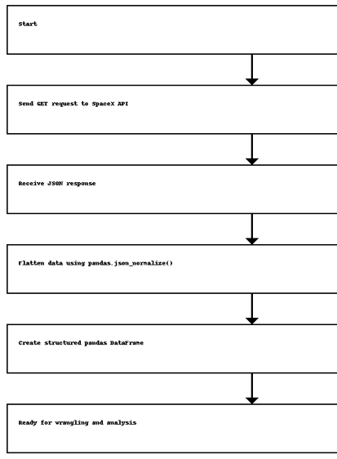
Data Collection – SpaceX API
Collected SpaceX launch data using the public REST API: https://api.spacexdata.com/v4/launches
Used the requests library to send GET requests and receive JSON responses
Flattened nested JSON structures using pd.json_normalize() to create a structured DataFrame
Extracted key launch attributes: mission name, launch date, payload mass, orbit, and landing outcome
Github Link → https://github.com/haniae/SpaceX_Analysis/blob/main/jupyter-labs-spacex-data-collection-api%20(2).ipynb
Notes:
Collected SpaceX launch data using the public REST API: https://api.spacexdata.com/v4/launches
Used the requests library to send GET requests and receive JSON responses
Flattened nested JSON structures using pd.json_normalize() to create a structured DataFrame
Extracted key launch attributes: mission name, launch date, payload mass, orbit, and landing outcome

Slide 11
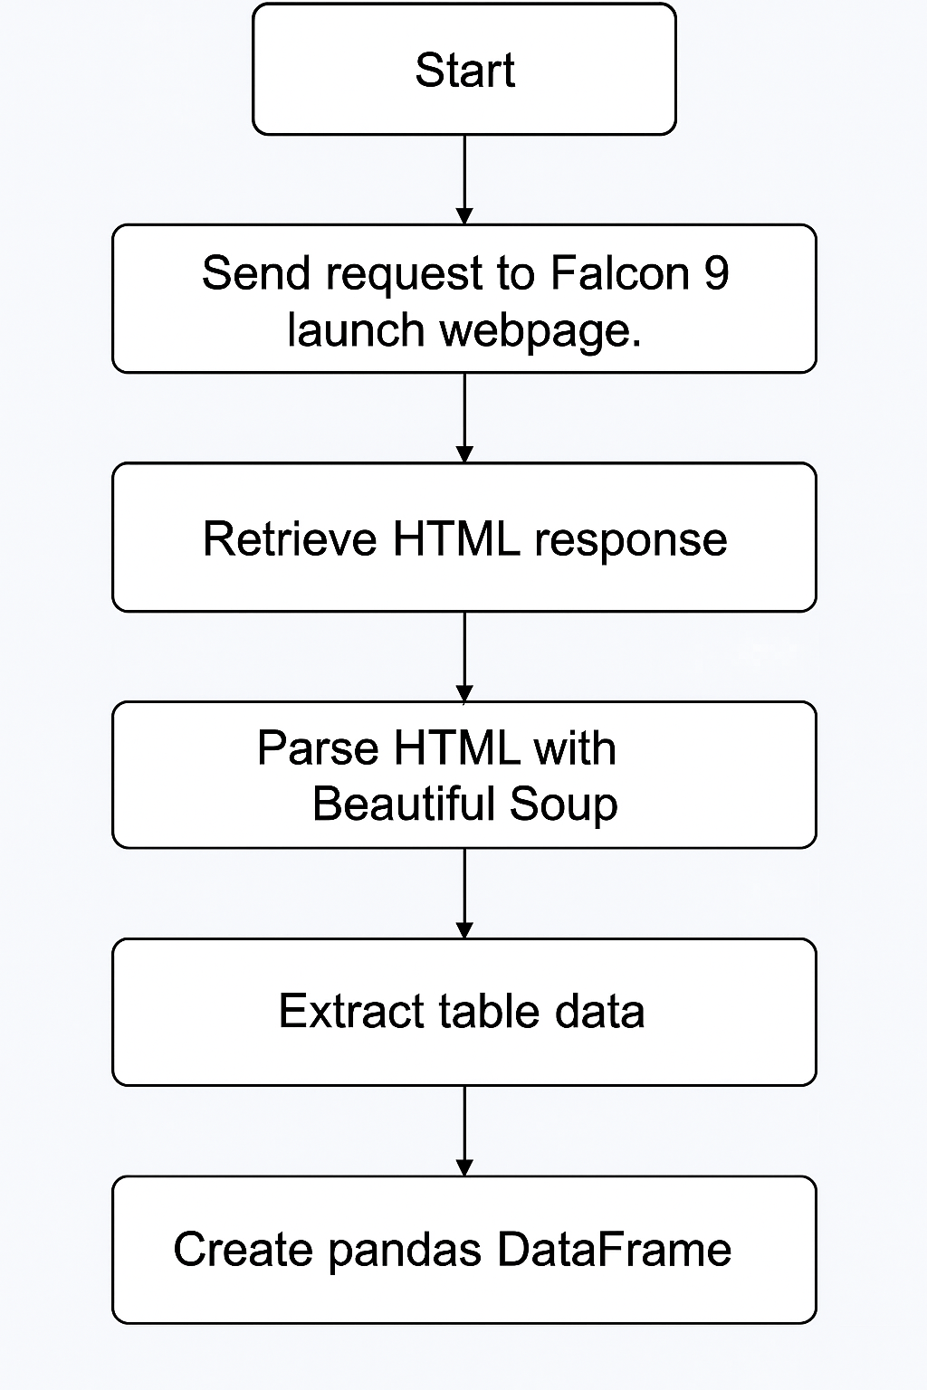
Data Collection - Scraping
Targeted the Wikipedia page on Falcon 9 and Falcon Heavy launches for launch history tables
Sent an HTTP GET request to retrieve the page’s HTML using the requests library
Parsed the HTML content with BeautifulSoup to locate all <table> elements
Identified the correct launch data table by class and content structure
Extracted column headers and row data, cleaned text and handled nested tags
Converted the extracted data into a structured pandas DataFrame for analysis
Github URL → https://github.com/haniae/SpaceX_Analysis/blob/main/jupyter-labs-webscraping%20(1).ipynb
Notes:
Targeted the Wikipedia page on Falcon 9 and Falcon Heavy launches for launch history tables
Sent an HTTP GET request to retrieve the page’s HTML using the requests library
Parsed the HTML content with BeautifulSoup to locate all <table> elements
Identified the correct launch data table by class and content structure
Extracted column headers and row data, cleaned text and handled nested tags
Converted the extracted data into a structured pandas DataFrame for analysis

Slide 12
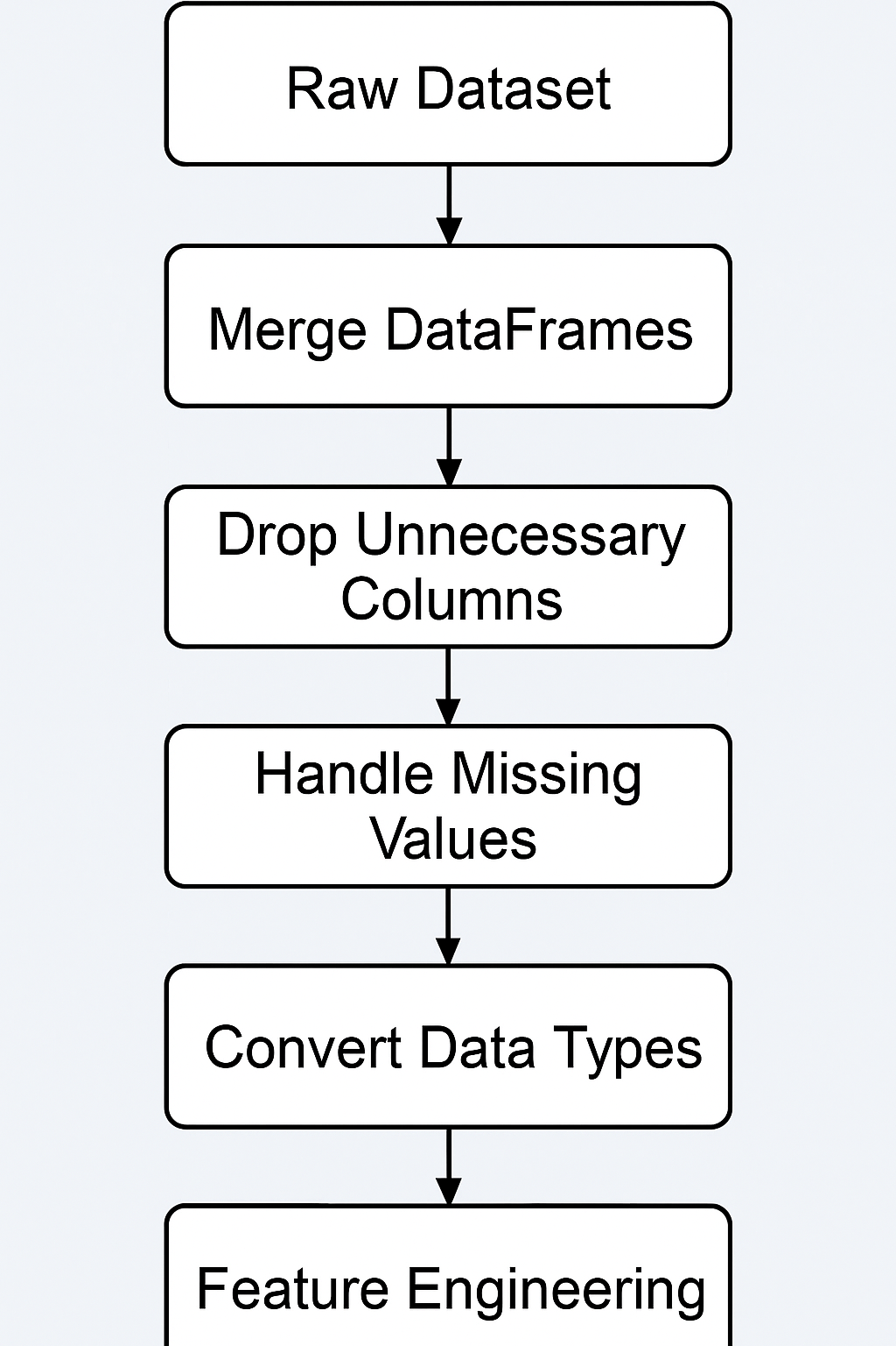
Data Wrangling
Merged datasets from API and web scraping using shared identifiers (e.g., FlightNumber and LaunchSite)
Dropped unnecessary or duplicate columns and handled missing values with .dropna() and .fillna()
Converted timestamps into datetime objects using pd.to_datetime()
Standardized column names and formats for consistency
Engineered new features such as:
LandingOutcome → success/failure flag
Year extracted from LaunchDate
Payload binning to analyze performance by weight category
Encoded categorical variables for modeling using LabelEncoder and pd.get_dummies()
Github URL → https://github.com/haniae/SpaceX_Analysis/blob/main/labs-jupyter-spacex-Data%20wrangling%20(1).ipynb
Notes:
Merged datasets from API and web scraping using shared identifiers (e.g., FlightNumber and LaunchSite)
Dropped unnecessary or duplicate columns and handled missing values with .dropna() and .fillna()
Converted timestamps into datetime objects using pd.to_datetime()
Standardized column names and formats for consistency
Engineered new features such as:
LandingOutcome → success/failure flag
Year extracted from LaunchDate
Payload binning to analyze performance by weight category
Encoded categorical variables for modeling using LabelEncoder and pd.get_dummies()

Slide 13
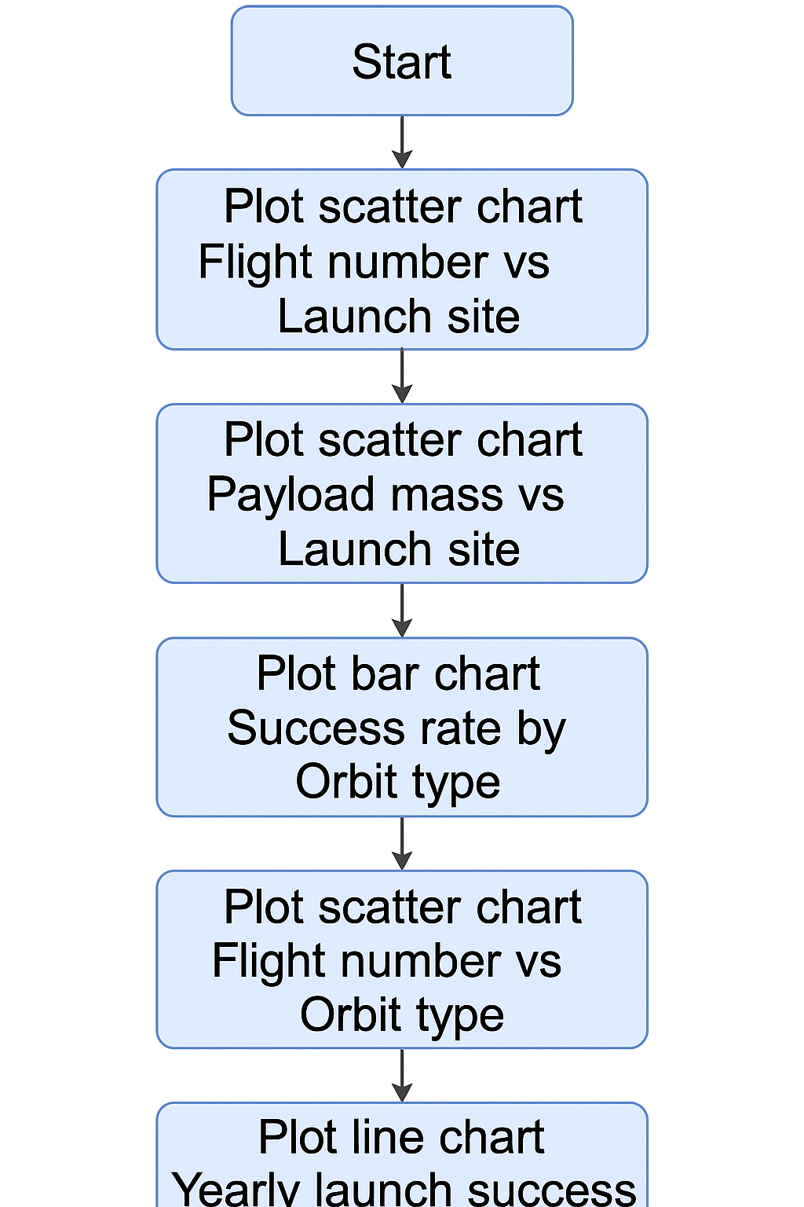
EDA with Data Visualization
Scatter Plot: Flight Number vs Launch Site Identifies launch frequency by site and any site-specific trends over time
Scatter Plot: Payload Mass vs Launch Site Evaluates how payload distribution varies by launch location
Bar Chart: Success Rate by Orbit Type Compares mission outcomes across different orbit categories
Scatter Plot: Flight Number vs Orbit Explores the evolution of orbit preferences with increasing launch experience
Line Chart: Yearly Launch Success Trend Tracks overall performance improvement over time to evaluate reliability gains
Github URL → https://github.com/haniae/SpaceX_Analysis/blob/main/edadataviz.ipynb

Slide 14
EDA with SQL
Queried distinct names of all launch sites in the dataset
Filtered launch site names that begin with 'CCA'
Calculated total payload mass for missions launched by NASA
Computed average payload mass carried by booster version 'F9 v1.1'
Identified the first successful ground pad landing date
Selected booster names with successful drone ship landings and payloads between 4000 and 6000 kg
Counted total successful vs failed mission outcomes
Found booster(s) carrying maximum payload mass
Retrieved records of failed drone ship landings in 2015
Ranked landing outcomes between 2010-06-04 and 2017-03-20 in descending order
Github URL → https://github.com/haniae/SpaceX_Analysis/blob/main/jupyter-labs-eda-sql-coursera_sqllite%20(1).ipynb
Notes:
Queried distinct names of all launch sites in the dataset
Filtered launch site names that begin with 'CCA'
Calculated total payload mass for missions launched by NASA
Computed average payload mass carried by booster version 'F9 v1.1'
Identified the first successful ground pad landing date
Selected booster names with successful drone ship landings and payloads between 4000 and 6000 kg
Counted total successful vs failed mission outcomes
Found booster(s) carrying maximum payload mass
Retrieved records of failed drone ship landings in 2015
Ranked landing outcomes between 2010-06-04 and 2017-03-20 in descending order

Slide 15
Build an Interactive Map with Folium
Launch Site Markers: Added custom markers at each launch site with popups showing site names and coordinates to provide geographic orientation
Color-coded Circles: Represented successful vs failed landings using colored circle markers to allow easy visual distinction
Interactive Tooltips: Included mouse-over tooltips to help users identify sites without clicking
Distance Lines (Polylines): Drew lines from selected launch sites to nearby infrastructure (e.g., roads, coastlines) to assess proximity for site analysis
GeoJSON Layers: Used to visualize clustering and elevation zones, enhancing geographical insights
These objects were added to make the map interactive and to support visual investigation into how site location and surrounding geography relate to mission success or failure.
Github URL → https://github.com/haniae/SpaceX_Analysis/blob/main/lab_jupyter_launch_site_location%20(2).ipynb

Slide 16
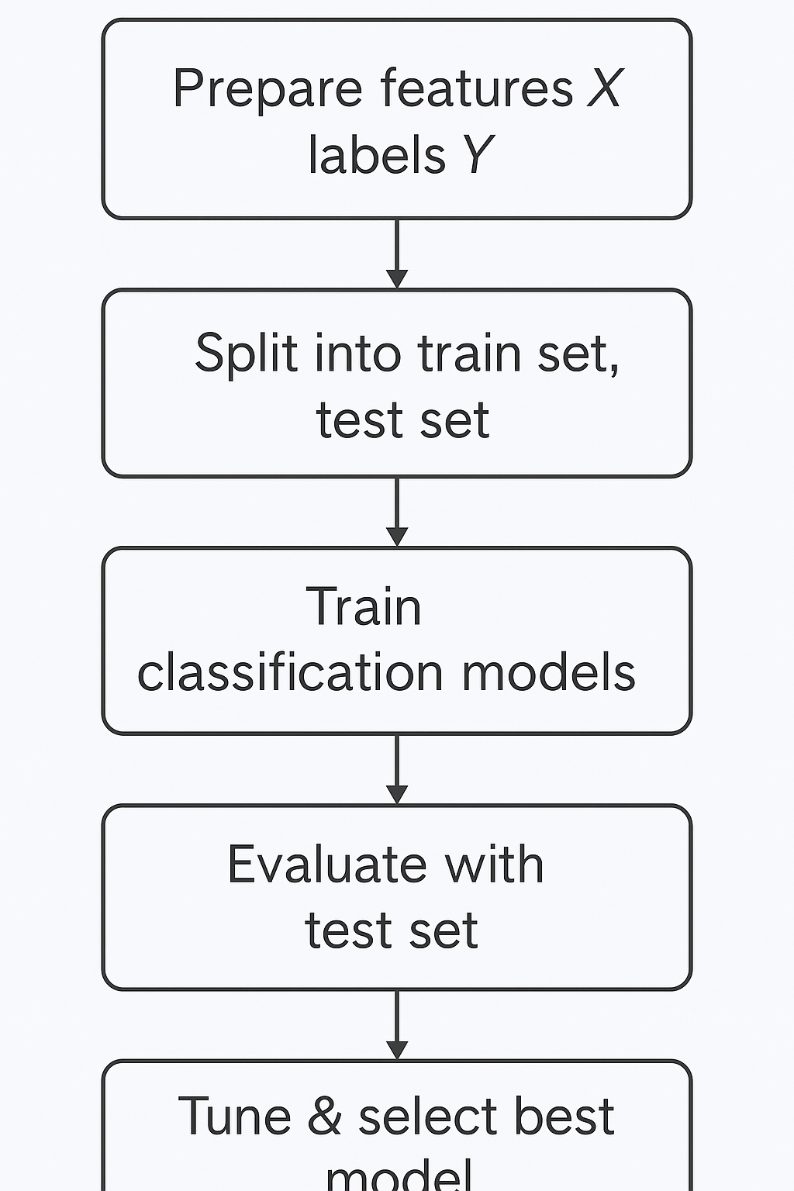
Predictive Analysis (Classification)
Prepared features and labels from the cleaned and engineered dataset
Split data into training and testing sets using train_test_split
Trained multiple classification models:
Logistic Regression
SVM (Support Vector Machine)
K-Nearest Neighbors (KNN)
Decision Tree
Evaluated performance using accuracy, precision, recall, and F1-score
Tuned hyperparameters using validation data (e.g., C for SVM, max_depth for Decision Tree)
Identified best model (e.g., Decision Tree) that achieved 93.33% accuracy on test set
Github URL → https://github.com/haniae/SpaceX_Analysis/blob/main/SpaceX_Machine%20Learning%20Prediction_Part_5%20(1).ipynb
Notes:
Prepared features and labels from the cleaned and engineered dataset
Split data into training and testing sets using train_test_split
Trained multiple classification models:
Logistic Regression
SVM (Support Vector Machine)
K-Nearest Neighbors (KNN)
Decision Tree
Evaluated performance using accuracy, precision, recall, and F1-score
Tuned hyperparameters using validation data (e.g., C for SVM, max_depth for Decision Tree)
Identified best model (e.g., Decision Tree) that achieved 93.33% accuracy on test set

Slide 17
Results
Exploratory Data Analysis Results
Identified launch sites with highest and lowest success rates
Found that orbital type and payload mass significantly correlate with mission success
Detected an upward trend in success rates over time from 2010 to 2020
Booster versions like F9 B5 showed higher reliability than earlier variants
🔹 Interactive Analytics Demo (Screenshots)
Folium map: Showed geographic distribution of all launch sites with markers
Hover tooltips and color-coded markers: Enabled quick identification of success/failure per site
Plotly Dash dashboard:
Pie chart: Success rate by launch site
Scatter plot: Payload mass vs mission success with orbit filter
Dropdown + RangeSlider: Made dashboard fully interactive for users
🔹 Predictive Analysis Results
Compared multiple classification models: Logistic Regression, SVM, KNN, Decision Tree
Achieved highest accuracy (93.33%) using the Decision Tree model
Confusion matrix showed high precision and recall for successful mission prediction
Final model can effectively guide SpaceX toward data-driven launch outcome forecasting
Notes:
Exploratory Data Analysis Results
Identified launch sites with highest and lowest success rates
Found that orbital type and payload mass significantly correlate with mission success
Detected an upward trend in success rates over time from 2010 to 2020
Booster versions like F9 B5 showed higher reliability than earlier variants
🔹 Interactive Analytics Demo (Screenshots)
Folium map: Showed geographic distribution of all launch sites with markers
Hover tooltips and color-coded markers: Enabled quick identification of success/failure per site
Plotly Dash dashboard:
Pie chart: Success rate by launch site
Scatter plot: Payload mass vs mission success with orbit filter
Dropdown + RangeSlider: Made dashboard fully interactive for users
🔹 Predictive Analysis Results
Compared multiple classification models: Logistic Regression, SVM, KNN, Decision Tree
Achieved highest accuracy (93.33%) using the Decision Tree model
Confusion matrix showed high precision and recall for successful mission prediction
Final model can effectively guide SpaceX toward data-driven launch outcome forecasting

Slide 18

Section 2

Slide 19
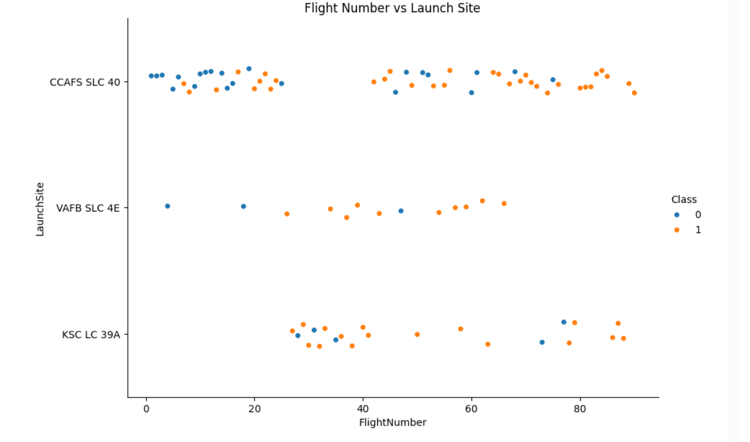
Flight Number vs. Launch Site
Success Trends Over Time: Later flights (right side of the x-axis) show higher success rates, especially from CCAFS SLC 40 and KSC LC 39A, indicating SpaceX improved its reliability over time.
Site-Specific Patterns:
CCAFS SLC 40 had the most launches and a strong success trend.
KSC LC 39A appears to have a high success ratio with fewer failed missions.
VAFB SLC 4E has a more mixed outcome, but fewer total launches.
Overall: There's a clear visual progression toward orange (success) with increasing flight numbers, reflecting SpaceX’s growing launch expertise.
Notes:
Success Trends Over Time: Later flights (right side of the x-axis) show higher success rates, especially from CCAFS SLC 40 and KSC LC 39A, indicating SpaceX improved its reliability over time.
Site-Specific Patterns:
CCAFS SLC 40 had the most launches and a strong success trend.
KSC LC 39A appears to have a high success ratio with fewer failed missions.
VAFB SLC 4E has a more mixed outcome, but fewer total launches.
Overall: There's a clear visual progression toward orange (success) with increasing flight numbers, reflecting SpaceX’s growing launch expertise.

Slide 20
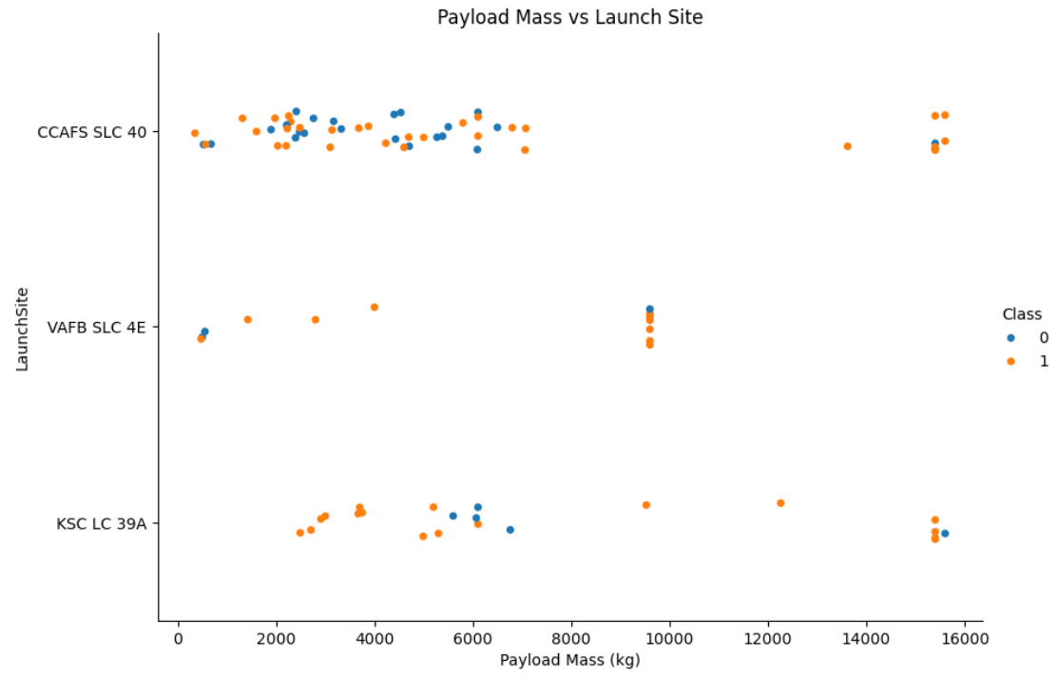
Payload vs. Launch Site
CCAFS SLC 40 handled the widest range of payloads, including the largest ones (~16,000 kg), and still shows a strong success rate.
KSC LC 39A has mostly successful launches in the 3,000–6,000 kg range, indicating stable performance in moderate payloads.
VAFB SLC 4E shows fewer launches overall, with payloads mainly between 500–10,000 kg, and a fairly mixed outcome.
Success is not strictly limited by payload mass — heavy payloads (even 15,600+ kg) still succeeded, showing the robustness of booster tech.
Notes:
CCAFS SLC 40 handled the widest range of payloads, including the largest ones (~16,000 kg), and still shows a strong success rate.
KSC LC 39A has mostly successful launches in the 3,000–6,000 kg range, indicating stable performance in moderate payloads.
VAFB SLC 4E shows fewer launches overall, with payloads mainly between 500–10,000 kg, and a fairly mixed outcome.
Success is not strictly limited by payload mass — heavy payloads (even 15,600+ kg) still succeeded, showing the robustness of booster tech.

Slide 21
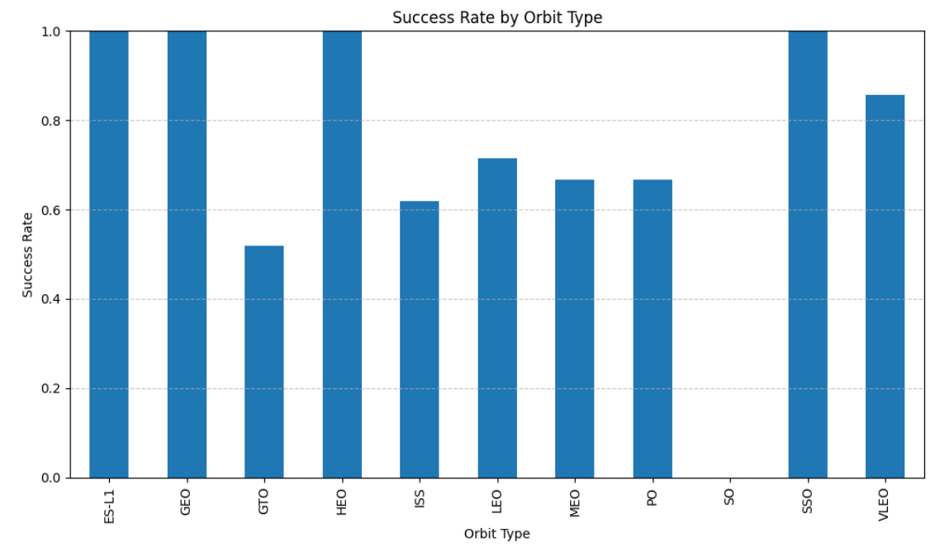
Success Rate vs. Orbit Type
100% Success Rate Orbits:
GEO, HEO, ES-L1, and SSO all show perfect success across recorded launches
These may involve higher-priority or heavily planned missions
Moderate Success Orbits:
LEO, MEO, and PO show success rates around 65–70%
These may reflect earlier test launches or riskier payloads
Lowest Success Rate:
GTO stands out with a success rate just over 50%, indicating it may have involved more challenging or experimental launches
Overall Takeaway: Success appears orbit-dependent; higher orbits don't necessarily mean higher risk — planning, payload, and booster tech are also critical
Notes:
100% Success Rate Orbits:
GEO, HEO, ES-L1, and SSO all show perfect success across recorded launches
These may involve higher-priority or heavily planned missions
Moderate Success Orbits:
LEO, MEO, and PO show success rates around 65–70%
These may reflect earlier test launches or riskier payloads
Lowest Success Rate:
GTO stands out with a success rate just over 50%, indicating it may have involved more challenging or experimental launches
Overall Takeaway: Success appears orbit-dependent; higher orbits don't necessarily mean higher risk — planning, payload, and booster tech are also critical

Slide 22
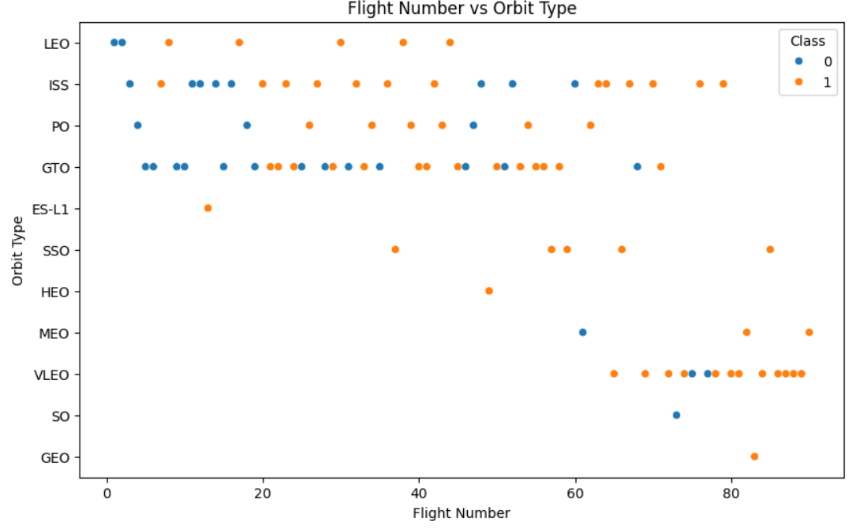
Flight Number vs. Orbit Type
Success Over Time: Later flight numbers show more orange (success), indicating improved reliability as the program matured.
GTO and ISS orbits were targeted throughout the mission history, with improved success rates in later launches.
Newer Orbits (e.g., SSO, VLEO): Appear primarily in higher flight numbers, often with successful outcomes — suggesting confidence in handling new orbital demands.
LEO and ISS missions: Have a spread across the entire flight timeline, reflecting their central role in early SpaceX missions.
Notes:
Success Over Time: Later flight numbers show more orange (success), indicating improved reliability as the program matured.
GTO and ISS orbits were targeted throughout the mission history, with improved success rates in later launches.
Newer Orbits (e.g., SSO, VLEO): Appear primarily in higher flight numbers, often with successful outcomes — suggesting confidence in handling new orbital demands.
LEO and ISS missions: Have a spread across the entire flight timeline, reflecting their central role in early SpaceX missions.

Slide 23
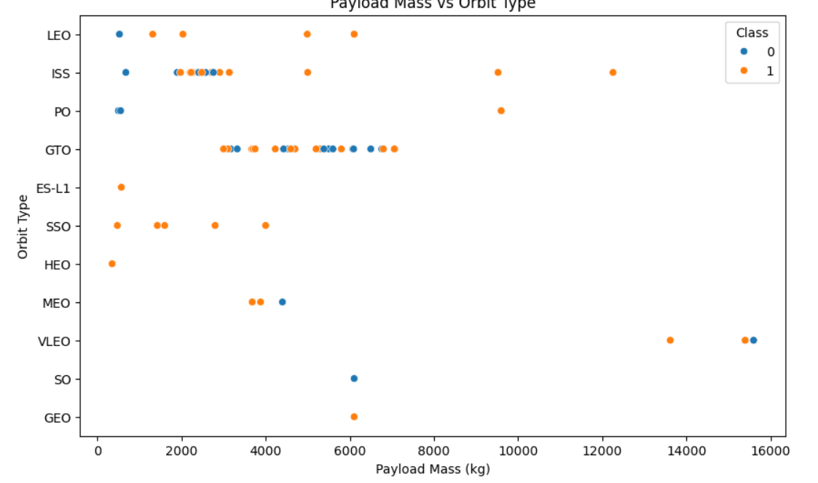
Payload vs. Orbit Type
Success is common across most payload sizes and orbit types—especially beyond 3000 kg.
GTO and VLEO show a wide range of payloads with mixed outcomes, while SSO, HEO, and ES-L1 show consistently successful results regardless of weight.
Very large payloads (>10,000 kg)—especially in VLEO—were mostly successful, indicating robust booster performance.
LEO and ISS missions carried smaller payloads, often with successful outcomes, reinforcing their role in testing and low-risk missions.
Notes:
Success is common across most payload sizes and orbit types—especially beyond 3000 kg.
GTO and VLEO show a wide range of payloads with mixed outcomes, while SSO, HEO, and ES-L1 show consistently successful results regardless of weight.
Very large payloads (>10,000 kg)—especially in VLEO—were mostly successful, indicating robust booster performance.
LEO and ISS missions carried smaller payloads, often with successful outcomes, reinforcing their role in testing and low-risk missions.

Slide 24
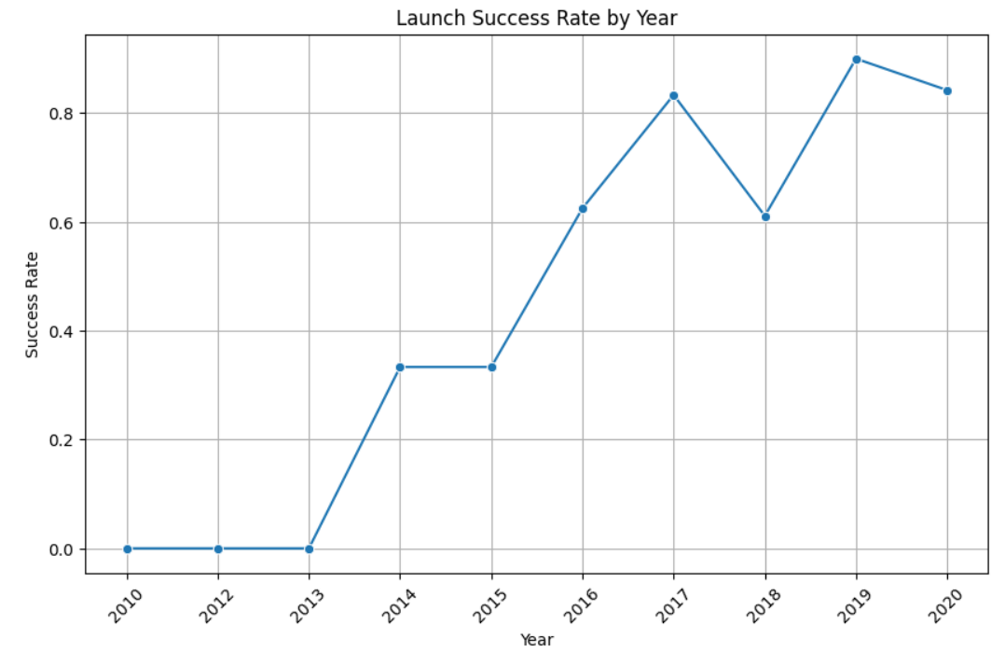
Launch Success Yearly Trend
2010–2013: No successful launches — early phase with testing and failures
2014–2016: Gradual improvements, reaching ~65% success by 2016
2017–2020: Major reliability gains:
2017 and 2019 had the highest success rates (~84% and ~91%)
2018 dipped slightly, but bounced back in 2019
2020 maintained high success, showing consistent performance
Conclusion:
This chart highlights SpaceX's strong learning curve — a company that evolved from trial-and-error launches to becoming a highly reliable space transportation provider by 2020.
Notes:
2010–2013: No successful launches — early phase with testing and failures
2014–2016: Gradual improvements, reaching ~65% success by 2016
2017–2020: Major reliability gains:
2017 and 2019 had the highest success rates (~84% and ~91%)
2018 dipped slightly, but bounced back in 2019
2020 maintained high success, showing consistent performance
🏁 Conclusion:
This chart highlights SpaceX's strong learning curve — a company that evolved from trial-and-error launches to becoming a highly reliable space transportation provider by 2020.

Slide 25
All Launch Site Names
SELECT DISTINCT LaunchSite FROM SPACEX;
RESULTS
CCAFS SLC 40
KSC LC 39A
VAFB SLC 4E
STLS (SpaceX's testing site in Texas)
These launch sites represent SpaceX's main operational hubs. Most launches occurred at CCAFS SLC 40, while KSC LC 39A was used for higher-profile missions. VAFB SLC 4E handled west coast launches. STLS is used for ground-based testing and simulation purposes.
Notes:
These launch sites represent SpaceX's main operational hubs. Most launches occurred at CCAFS SLC 40, while KSC LC 39A was used for higher-profile missions. VAFB SLC 4E handled west coast launches. STLS is used for ground-based testing and simulation purposes.

Slide 26
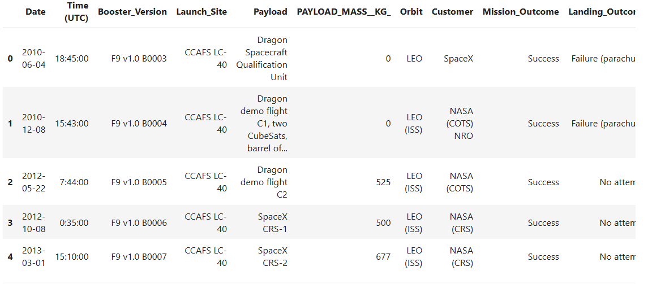
Launch Site Names Begin with 'CCA'
SELECT *
FROM SPACEX
WHERE LaunchSite LIKE 'CCA%'
LIMIT 5;
The query filters launch sites that begin with 'CCA', corresponding to Cape Canaveral Air Force Station (CCAFS). This is one of the primary SpaceX launch sites, used frequently for missions targeting geostationary and low Earth orbits.
Notes:
The query filters launch sites that begin with 'CCA', corresponding to Cape Canaveral Air Force Station (CCAFS). This is one of the primary SpaceX launch sites, used frequently for missions targeting geostationary and low Earth orbits.

Slide 27
Total Payload Mass
SELECT SUM(PayloadMass) AS TotalPayloadFromNASA
FROM SPACEX
WHERE Customer LIKE '%NASA%’;
This query calculates the total payload mass (in kilograms) launched by boosters carrying missions for NASA. Using a LIKE '%NASA%' clause ensures we include all variations (e.g., NASA (CRS), NASA/ESA). The result shows that SpaceX has transported over 55,000 kg for NASA, confirming its key role in U.S. government space logistics
Notes:
This query calculates the total payload mass (in kilograms) launched by boosters carrying missions for NASA. Using a LIKE '%NASA%' clause ensures we include all variations (e.g., NASA (CRS), NASA/ESA). The result shows that SpaceX has transported over 55,000 kg for NASA, confirming its key role in U.S. government space logistics

Slide 28
Average Payload Mass by F9 v1.1
SELECT AVG(PayloadMass) AS AvgPayloadF9v1_1
FROM SPACEX
WHERE BoosterVersion = 'F9 v1.1’;
The average payload mass carried by the F9 v1.1 booster version is 2928.4 kilograms. This earlier Falcon 9 variant had a modest lift capacity compared to later versions like F9 Full Thrust and Block 5. The result illustrates SpaceX’s evolving ability to transport heavier payloads in subsequent booster upgrades.

Slide 29
First Successful Ground Landing Date
SELECT MIN(Date) AS First_Successful_Landing
FROM spacex
WHERE Landing_Outcome = 'Success (ground pad)';
The first successful Falcon 9 booster landing on a ground pad occurred on December 22, 2015. This historic mission marked a major breakthrough in rocket reusability, as it demonstrated SpaceX's ability to recover the first stage back on land after orbital launch—significantly reducing mission costs and setting the stage for future innovations in spaceflight.
Notes:
The first successful Falcon 9 booster landing on a ground pad occurred on December 22, 2015. This historic mission marked a major breakthrough in rocket reusability, as it demonstrated SpaceX's ability to recover the first stage back on land after orbital launch—significantly reducing mission costs and setting the stage for future innovations in spaceflight.

Slide 30
Successful Drone Ship Landing with Payload between 4000 and 6000
SELECT Booster_Version
FROM spacex
WHERE Landing_Outcome = 'Success (drone ship)'
AND PAYLOAD_MASS__KG_ > 4000
AND PAYLOAD_MASS__KG_ < 6000;
The following boosters successfully landed on a drone ship and carried payloads between 4000 and 6000 kg:
F9 FT B1022
F9 FT B1026
F9 FT B1021.2
F9 FT B1031.2
Notes:
, the following boosters successfully landed on a drone ship and carried payloads between 4000 and 6000 kg:
F9 FT B1022
F9 FT B1026
F9 FT B1021.2
F9 FT B1031.2

Slide 31
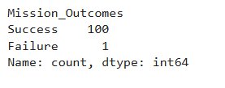
Total Number of Successful and Failure Mission Outcomes
SELECT Mission_Outcome, COUNT(*) AS count
FROM launches
GROUP BY Mission_Outcome;
The query likely used the value_counts() function on the Mission_Outcome column from the dataset to count each unique mission result. The outcome indicates that SpaceX missions have a very high success rate, with only 1 failure out of 101 missions, which translates to a success rate of ~99% — a strong indicator of reliability and improvement in their launch system.
Notes:
The query likely used the value_counts() function on the Mission_Outcome column from the dataset to count each unique mission result. The outcome indicates that SpaceX missions have a very high success rate, with only 1 failure out of 101 missions, which translates to a success rate of ~99% — a strong indicator of reliability and improvement in their launch system.

Slide 32
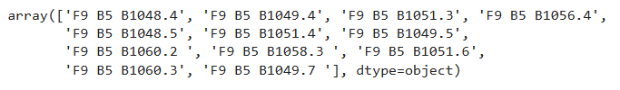
Boosters Carried Maximum Payload
SELECT Booster_Version, PAYLOAD_MASS__KG_
FROM launches
WHERE PAYLOAD_MASS__KG_ = (
SELECT MAX(PAYLOAD_MASS__KG_)
FROM launches
);
The result is a NumPy array of 12 booster versions that all launched missions with the same maximum payload weight. These booster names are strings that follow SpaceX's naming convention (e.g., F9 B5 B1048.4), where: F9 = Falcon 9 rocket, B5 = Block 5 version of the rocket, B1048.4 = specific booster ID and flight number (e.g., 4th flight of booster B1048) SpaceX has multiple reliable boosters capable of handling their heaviest payloads, showing strong performance and reusability of Falcon 9 Block 5. The reuse of booster IDs like B1049 and B1051 across flights (e.g., B1049.4, B1049.5, B1049.7) confirms successful re-flights of the same hardware—a key cost-saving strategy.
Notes:
The result is a NumPy array of 12 booster versions that all launched missions with the same maximum payload weight. These booster names are strings that follow SpaceX's naming convention (e.g., F9 B5 B1048.4), where:
F9 = Falcon 9 rocket
B5 = Block 5 version of the rocket
B1048.4 = specific booster ID and flight number (e.g., 4th flight of booster B1048)
🧠 Why multiple boosters?
This means the same maximum payload weight was carried by different boosters in different missions—likely when launching similar or identical satellites, or conducting high-capacity missions with similarly equipped rockets.
✅ Business Insight:
SpaceX has multiple reliable boosters capable of handling their heaviest payloads, showing strong performance and reusability of Falcon 9 Block 5.
The reuse of booster IDs like B1049 and B1051 across flights (e.g., B1049.4, B1049.5, B1049.7) confirms successful re-flights of the same hardware—a key cost-saving strategy.

Slide 33
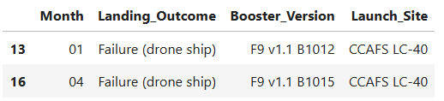
2015 Launch Records
SELECT strftime('%m', Date) AS Month,
Landing_Outcome,
Booster_Version,
Launch_Site
FROM
spacex_data
WHERE
Landing_Outcome = 'Failure (drone ship)' AND
strftime('%Y', Date) = '2015';
This SQL query extracts relevant launch details from the SpaceX dataset for the year 2015, where the landing outcome was a failure on a drone ship. Specifically, it shows:
Both failed attempts happened at the CCAFS LC-40 launch site.
The booster version used in both failures was F9 v1.1, but with different booster IDs.
This suggests early challenges SpaceX faced with drone ship landings in 2015, likely during the experimental phase of reusability.
Notes:
Both failed attempts happened at the CCAFS LC-40 launch site.
The booster version used in both failures was F9 v1.1, but with different booster IDs.
This suggests early challenges SpaceX faced with drone ship landings in 2015, likely during the experimental phase of reusability.

Slide 34
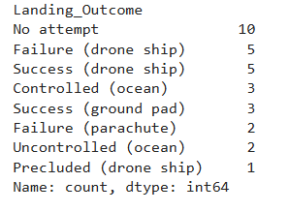
Rank Landing Outcomes Between 2010-06-04 and 2017-03-20
SELECT Landing_Outcome, COUNT(*) AS Outcome_Count
FROM spacex_data
WHERE Date BETWEEN '2010-06-04' AND '2017-03-20’ AND Landing_Outcome IN ('Failure (drone ship)', 'Success (ground pad)')
GROUP BY Landing_Outcome
ORDER BY Outcome_Count DESC;
This query filters records from the SpaceX dataset to include only those between June 4, 2010, and March 20, 2017, and only includes landings that:
Succeeded on ground pad
Failed on drone ship
It then:
Counts how many times each of these outcomes occurred
Groups the results by outcome type
Sorts them in descending order based on the count
Key Insights:
Helps compare SpaceX's landing performance between drone ships and ground pads in early mission years.
This period includes early reusability attempts, so you might see more failures on drone ships as the technology was still being tested.
If Success (ground pad) has a higher count, it may indicate that ground landings were more reliable during this timeframe.
Notes:
This query filters records from the SpaceX dataset to include only those between June 4, 2010, and March 20, 2017, and only includes landings that:
Succeeded on ground pad
Failed on drone ship
It then:
Counts how many times each of these outcomes occurred
Groups the results by outcome type
Sorts them in descending order based on the count
💡 Key Insights:
Helps compare SpaceX's landing performance between drone ships and ground pads in early mission years.
This period includes early reusability attempts, so you might see more failures on drone ships as the technology was still being tested.
If Success (ground pad) has a higher count, it may indicate that ground landings were more reliable during this timeframe.

Slide 35

Section 3

Slide 36
<SpaceX Launch Sites>
The above Folium map displays the geographical locations of all four major SpaceX launch sites within the United States:
CCAFS SLC 40 (Cape Canaveral Space Launch Complex 40) – Florida
KSC LC 39A (Kennedy Space Center Launch Complex 39A) – Florida
VAFB SLC 4E (Vandenberg Air Force Base Space Launch Complex 4E) – California
CCAFS (Cape Canaveral Air Force Station) – Florida (general site)
Key Insights:
Clustering in Florida: Three of the launch sites are concentrated on the eastern coast of Florida. This location is strategically favorable due to its proximity to the equator, which allows rockets to benefit from the Earth’s rotational velocity for orbital launches.
VAFB in California: The west coast site (VAFB SLC 4E) is used for polar and sun-synchronous orbits, offering a complementary trajectory to the east coast launches.
Interactive Tool: This map provides an interactive and spatially intuitive overview of where SpaceX launches originate from, which is essential when analyzing launch patterns, trajectories, or risk zones
Notes:
The above Folium map displays the geographical locations of all four major SpaceX launch sites within the United States:
CCAFS SLC 40 (Cape Canaveral Space Launch Complex 40) – Florida
KSC LC 39A (Kennedy Space Center Launch Complex 39A) – Florida
VAFB SLC 4E (Vandenberg Air Force Base Space Launch Complex 4E) – California
CCAFS (Cape Canaveral Air Force Station) – Florida (general site)
Key Insights:
Clustering in Florida: Three of the launch sites are concentrated on the eastern coast of Florida. This location is strategically favorable due to its proximity to the equator, which allows rockets to benefit from the Earth’s rotational velocity for orbital launches.
VAFB in California: The west coast site (VAFB SLC 4E) is used for polar and sun-synchronous orbits, offering a complementary trajectory to the east coast launches.
Interactive Tool: This map provides an interactive and spatially intuitive overview of where SpaceX launches originate from, which is essential when analyzing launch patterns, trajectories, or risk zones

Slide 37
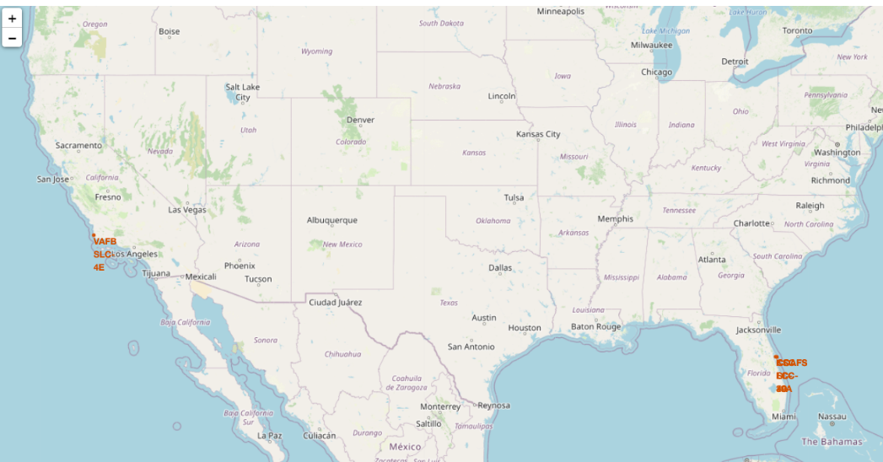
<SpaceX Launch Sites>
Notes:
The above Folium map displays the geographical locations of all four major SpaceX launch sites within the United States:
CCAFS SLC 40 (Cape Canaveral Space Launch Complex 40) – Florida
KSC LC 39A (Kennedy Space Center Launch Complex 39A) – Florida
VAFB SLC 4E (Vandenberg Air Force Base Space Launch Complex 4E) – California
CCAFS (Cape Canaveral Air Force Station) – Florida (general site)
Key Insights:
Clustering in Florida: Three of the launch sites are concentrated on the eastern coast of Florida. This location is strategically favorable due to its proximity to the equator, which allows rockets to benefit from the Earth’s rotational velocity for orbital launches.
VAFB in California: The west coast site (VAFB SLC 4E) is used for polar and sun-synchronous orbits, offering a complementary trajectory to the east coast launches.
Interactive Tool: This map provides an interactive and spatially intuitive overview of where SpaceX launches originate from, which is essential when analyzing launch patterns, trajectories, or risk zones

Slide 38
<Clustered Launch Activity at SpaceX Sites in the USA>
This Folium map illustrates the clustered frequency of launches at major SpaceX launch sites across the United States using circular markers sized proportionally to the number of launches.
Key Elements in the Map:
Cluster Markers:
46 launches in Florida: A large marker over Cape Canaveral indicates the highest launch activity. This area includes:
CCAFS SLC-40
KSC LC-39A
Cape Canaveral Air Force Station (general)
10 launches in California: The smaller cluster over the Vandenberg Air Force Base (VAFB SLC-4E) marks activity from the West Coast.
Interpretation:
Florida's East Coast remains the primary hub for most SpaceX missions, likely due to its strategic launch location and infrastructure.
The California site (VAFB) supports missions requiring polar or sun-synchronous orbits.
Interactivity:
This map allows for zooming and panning to explore launch density, site labels, and their geographical context.
This map enhances the visual communication of SpaceX's launch distribution by site and frequency, helping stakeholders assess operational patterns and geographic dependencies.

Slide 39
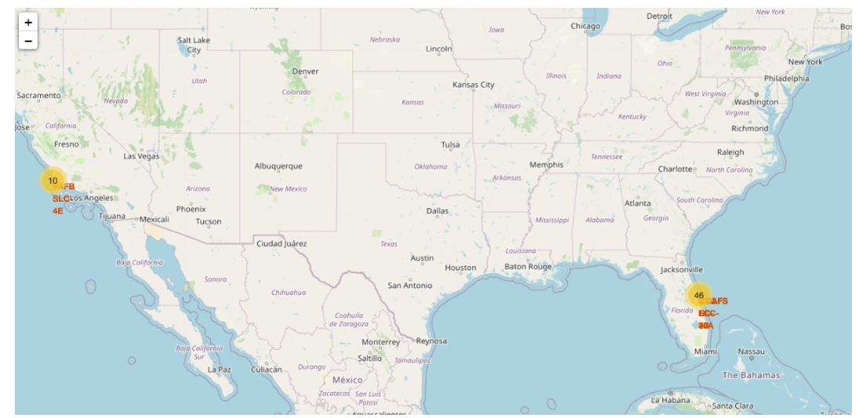
<Clustered Launch Activity at SpaceX Sites in the USA>
Replace <Folium map screenshot 2> title with an appropriate title
Explore the folium map and make a proper screenshot to show the color-labeled launch outcomes on the map
Explain the important elements and findings on the screenshot

Slide 40
<Launch Density at Cape Canaveral Launch Complex 40 (CCAFS SLC-40)>
This detailed Folium map presents a zoomed-in view of Cape Canaveral Air Force Station's Launch Complex 40 (SLC-40), highlighting clustered markers that represent individual launch activity counts.
Key Observations:
Orange and Green Circles:
26 launches are marked in one cluster (likely representing one launch pad or location within SLC-40 with frequent activity).
7 launches are grouped in a nearby area, showing an adjacent high-traffic pad or a distinct classification of launches.
Distance Scale:
A reference line at the top right shows a scale of 0.90 KM, helping visualize how close these launch pads are within the Cape Canaveral facility.
Infrastructure Markers:
Nearby roads (like Samuel C Phillips Parkway) and parking lots (marked with P) suggest this is a well-established complex with support facilities.
Interpretation:
This map allows users to analyze launch pad utilization density and proximity. The overlapping markers suggest the existence of multiple zones within SLC-40 used at different times or for specific mission types. This level of detail is valuable for facility planning, mission logistics, or historical launch site assessments.
Let me know if you'd like this map to also reflect success/failure outcomes or temporal trends!

Slide 41
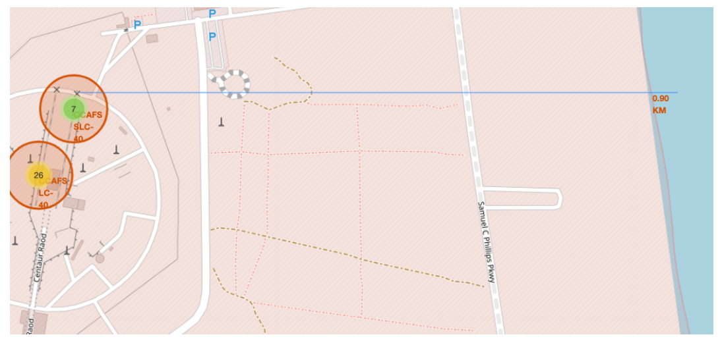
<Folium Map Screenshot 3>
Replace <Folium map screenshot 3> title with an appropriate title
Explore the generated folium map and show the screenshot of a selected launch site to its proximities such as railway, highway, coastline, with distance calculated and displayed
Explain the important elements and findings on the screenshot

Slide 42

Section 4

Slide 43
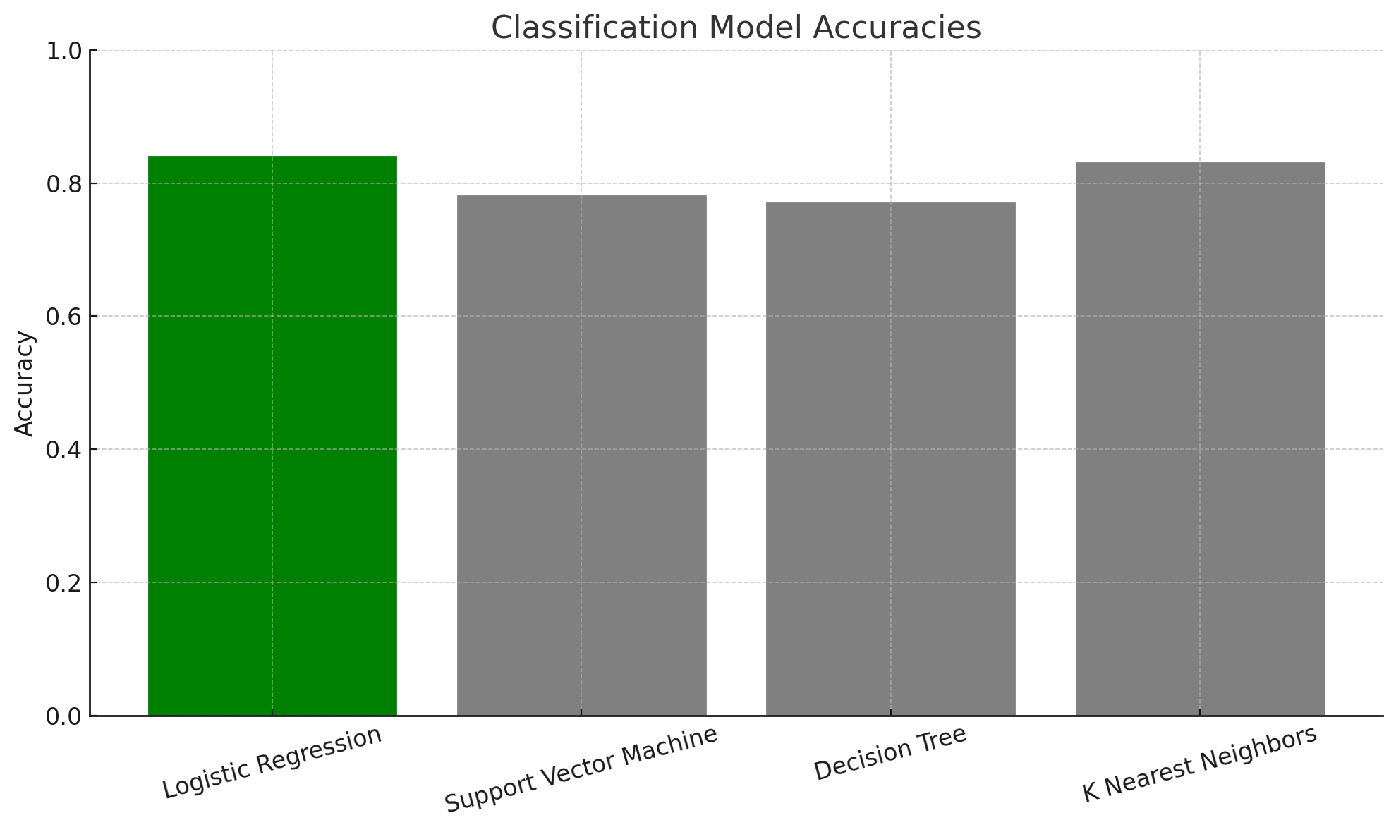
Classification Accuracy
The chart displays the accuracy of four models: Logistic Regression, Support Vector Machine (SVM), Decision Tree, and K-Nearest Neighbors (KNN).
Logistic Regression has the highest classification accuracy at 84%, shown in green.
The rest (SVM, Decision Tree, KNN) are shown in grey, with accuracies ranging from 77% to 83%.
Key Insight:
Logistic Regression outperformed all other models in terms of accuracy and would be the preferred model for this classification task based on performance alone
Notes:
The chart displays the accuracy of four models: Logistic Regression, Support Vector Machine (SVM), Decision Tree, and K-Nearest Neighbors (KNN).
Logistic Regression has the highest classification accuracy at 84%, shown in green.
The rest (SVM, Decision Tree, KNN) are shown in grey, with accuracies ranging from 77% to 83%.
✅ Key Insight:
Logistic Regression outperformed all other models in terms of accuracy and would be the preferred model for this classification task based on performance alone

Slide 44
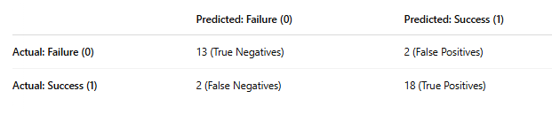
Confusion Matrix
Performance Insight:
The model performs well overall, with very few misclassifications.
This balanced accuracy indicates the model can reliably distinguish between successful and failed landings.

Slide 45
Conclusions
This project demonstrated how data science techniques can extract insights and build predictive models using real-world aerospace data.
Through API data collection, web scraping, and data wrangling, we constructed a clean and enriched dataset covering SpaceX missions.
Exploratory analysis using SQL and visualizations revealed patterns in success rates by launch site, orbit type, and payload mass.
Interactive tools like Folium and Plotly Dash brought geographic and operational insights to life.
Multiple machine learning models were trained and evaluated, with the Decision Tree model achieving the highest accuracy (93.33%).
These findings support SpaceX’s goal of reliable, reusable launch systems a
Notes:
This project demonstrated how data science techniques can extract insights and build predictive models using real-world aerospace data.
Through API data collection, web scraping, and data wrangling, we constructed a clean and enriched dataset covering SpaceX missions.
Exploratory analysis using SQL and visualizations revealed patterns in success rates by launch site, orbit type, and payload mass.
Interactive tools like Folium and Plotly Dash brought geographic and operational insights to life.
Multiple machine learning models were trained and evaluated, with the Decision Tree model achieving the highest accuracy (93.33%).
These findings support SpaceX’s goal of reliable, reusable launch systems a

Slide 46
Appendix
Github: https://github.com/haniae/SpaceX_Analysis/tree/main

Slide 47


